Slide 1
Week 12 CIS 215
Recovery and clean up after incident

Slide 2
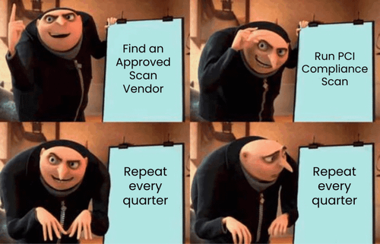
Signs a System Is Compromised
Slow performance, crashes, high CPU or network use
Unknown programs, accounts or scheduled tasks
Antivirus disabled, pop-ups, browser redirects
Some infections show no signs at all

Slide 3

Don't Panic, Follow a Plan
Emergencies are when people make mistakes
Have a checklist ready before you need it
Follow your incident response plan if one exists

Slide 4
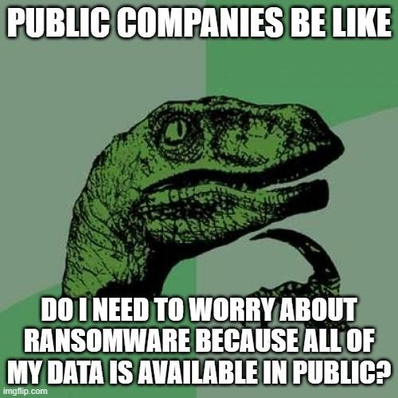
Containment
Disconnect from the network, but don't power off yet
Stop the spread to other systems
Change passwords from a clean device

Slide 5
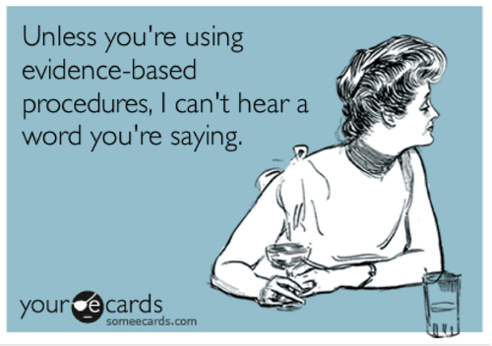
Preserving Evidence
Why evidence matters: legal, insurance, and finding the root cause
Memory disappears when you power off
Take screenshots and notes, and record the timeline
Chain of custody basics

Slide 6
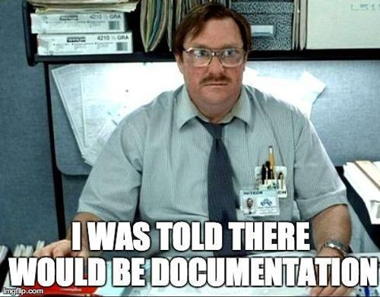
Documenting the Incident
What happened, when, what was affected, what was done
The documentation helps you next time, and auditors will ask for it

Slide 7
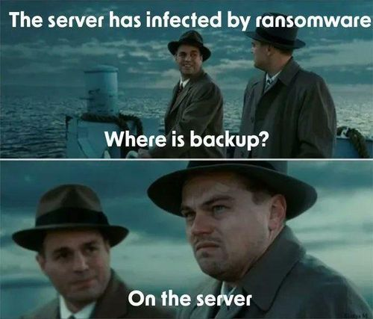
Clean or Rebuild?
Cleaning: faster, but you can't be sure it worked
Rebuilding: slower, but you know the result is clean
Industry rule of thumb: if in doubt, rebuild
Rootkits and firmware infections mean rebuild

Slide 8

Rebuilding from a Known Good Image
Golden images and why they need to stay current
Restore data from backups, not programs
Check that the backups aren't infected too

Slide 9
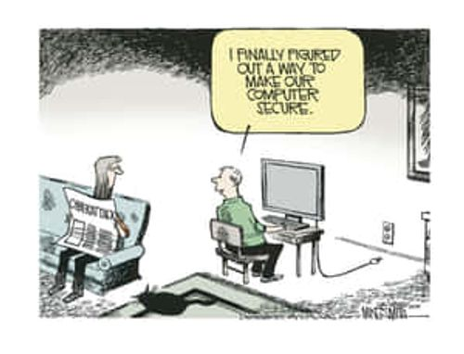
Verifying the System Is Clean
Scan with several tools
Watch network traffic and logs after reconnecting
Patch the hole that let the attacker in before going back to production

Slide 10
Personal Device Recovery
What to do if your own computer or phone is infected
Back up personal files regularly (3-2-1 rule)
  The 3-2-1 backup rule is a data protection strategy that requires maintaining three copies of your data on two different types of storage media, with one copy stored off-site
When to factory reset
Check your accounts for unauthorized access afterwards

Slide 11
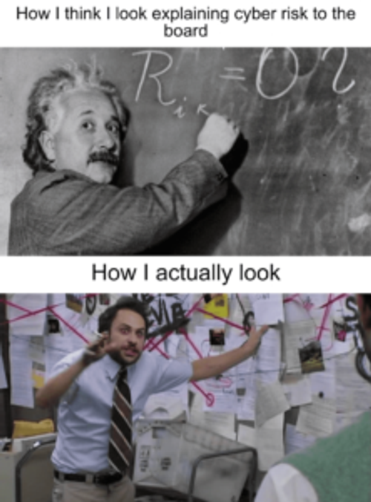
Lessons Learned
How did they get in, and how do we stop it next time?
Blameless reviews: focus on fixing the process
Update the plan and the training

Slide 12
Wrap Up and Activity
Activity: given an infection scenario, decide whether to clean or rebuild and justify the decision
Scenario 1: The Accounting Workstation. An employee in accounting has pop-ups and a slow computer. Antivirus removes a trojan, but the firewall logs show the machine has been contacting an unknown IP address every night for two weeks. The employee has access to payroll and the company bank account.
The Free PDF Converter. A student's personal laptop has a hijacked homepage and ads everywhere after they installed a free PDF converter. There's no work or school data on it, and the files are backed up to the cloud.

